Slide 1

DRIVERLESS AUTONOMOUS CAR

Slide 2
Contents
01
Obstacle Avoidance
02
Robot Gripper
03
Line Follower
04
Wi-fi & Bluetooth Control
05
Human Machine Interaction – Raspberry Pi

Slide 3
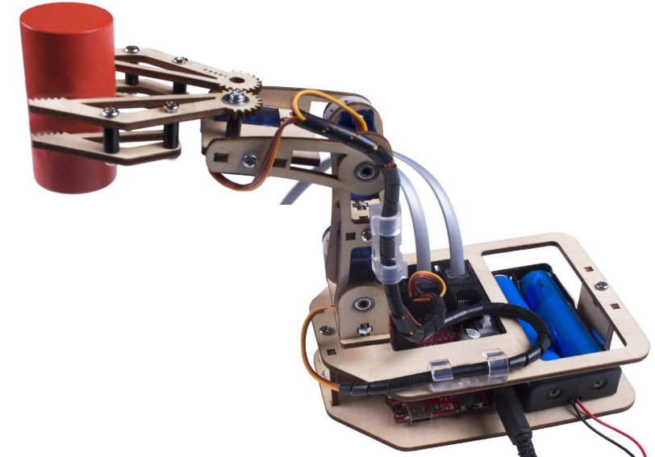
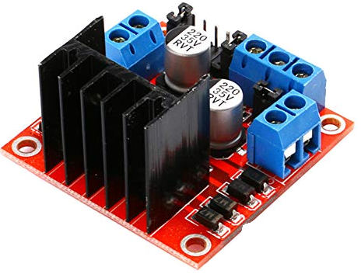
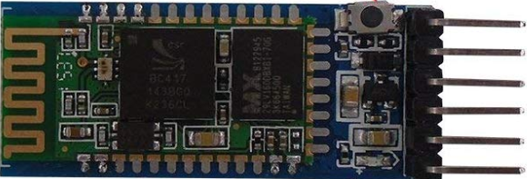
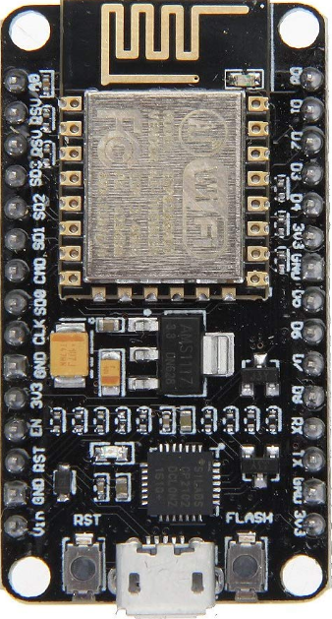
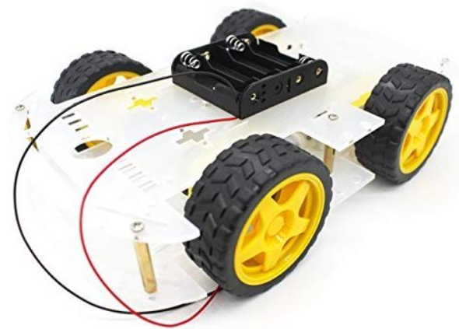
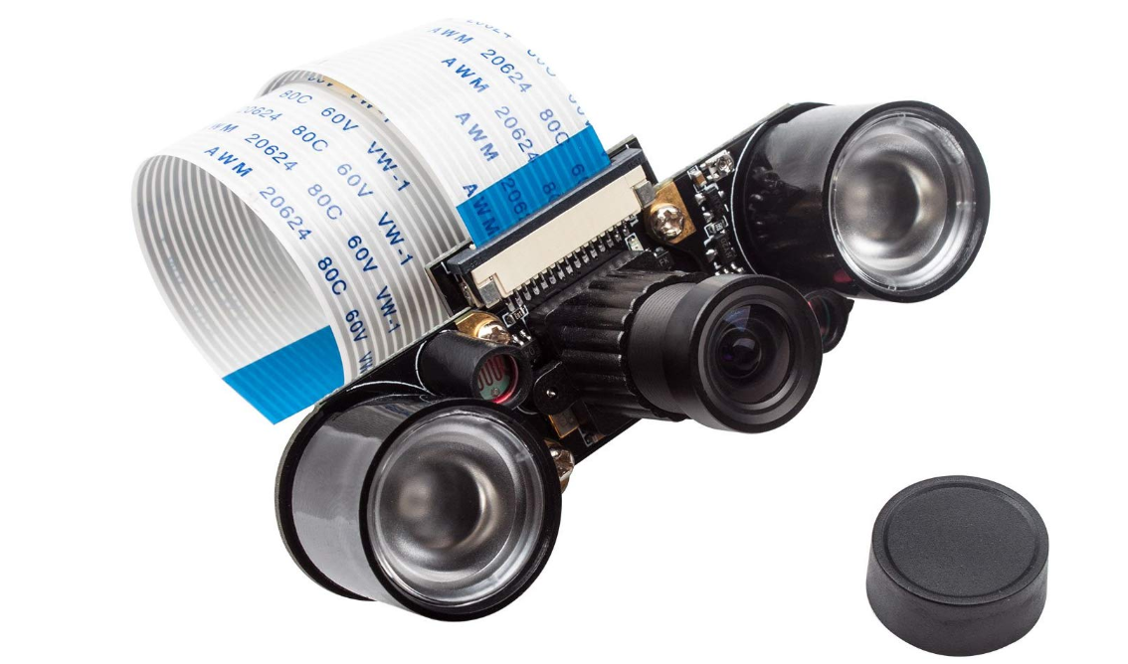
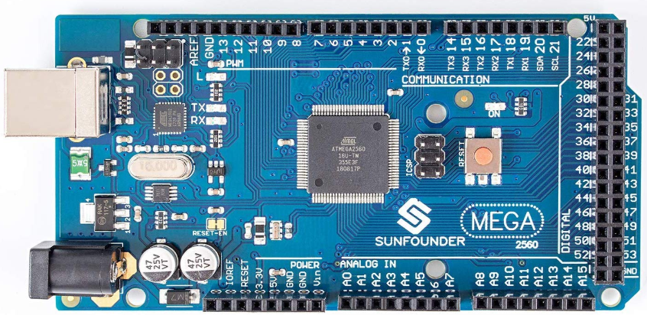
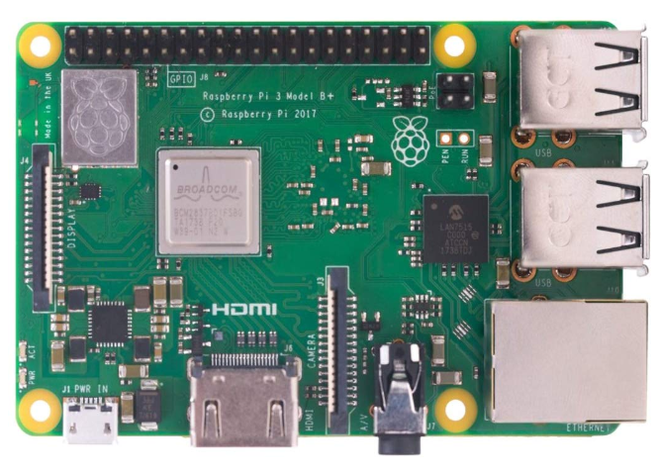
System
Robotic Arm Kit – Wooden
Four servos compose and control the four joints, and grippers have double layers
L298 Dual H-Bridge Motor Driver
L298 Dual H-Bridge is used for drive the motor and need power source from battery.
HC-05 Bluetooth & ESP8266 Wi-fi
Bluetooth module HC-05 Master and ESP8266 Wi-fi module
Robot Chassis & Wheels
Robot Body, Can extend electronics system like Raspberry Pi, Arduino etc.
Camera Module Raspberry-Pi
Web camera for Raspberry Pi 4 and Supports night vision and video recording function.
Arduino Board – Code & Drive (<>)
The MEGA 2560 Board can be powered via the USB connection or with an external power supply.
Raspberry-Pi 3 Operating System
1. 4GHz 64-bit quad-core ARMv8 CPU (BCM2837B0), 1 GB RAM.

Slide 4
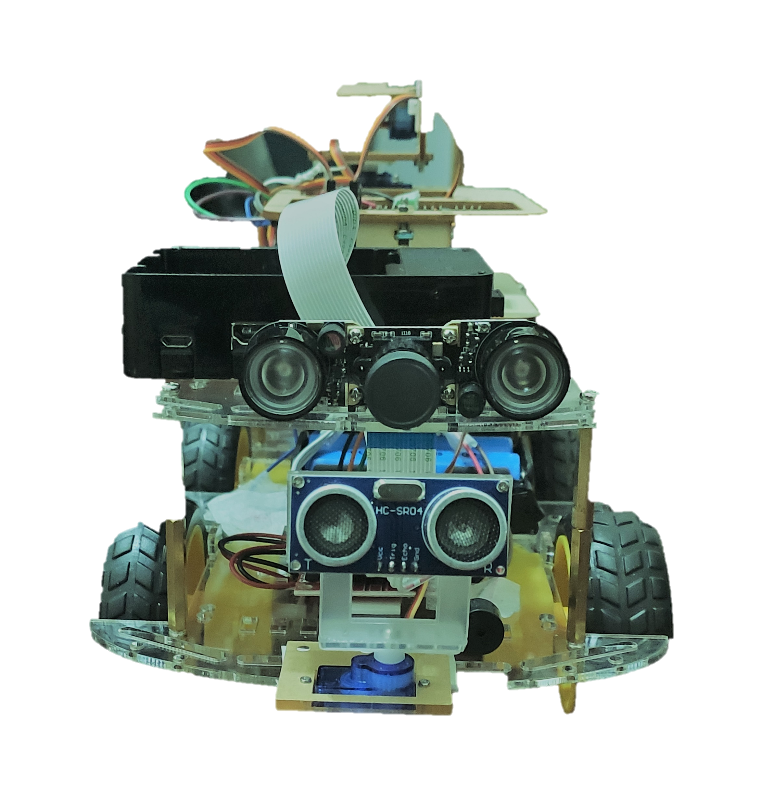
Obstacle Avoidance
Open source code circuit design, program development interface free download, can also be modified according to your needs.
Through the infrared obstacle avoidance sensor, it can realize automatic following or obstacle avoidance function.
It can be used as a regional exploration robot and an emergency rescue robot’s motion system, allowing the robot to automatically avoid obstacles while traveling.

Slide 5
Robot Gripper & Line Follower
A gripper is a device which enables an object to be manipulated. Just like a hand, a gripper enables holding, tightening, handling and releasing of an object.
Industrial robots for tasks normally carried out by human hands has led to the need for more effective handling equipment, especially pretension tools.
Grippers are mainly applicable for pick and place a work piece or a component. Load carrying capacity will differs depends upon the nature of the application of the robot.
The line follower robot project is based on light and black & white color. The behavior of light thrown on black or white color decides the robot movements. White surface fully reflects the light whereas black surface absorbs the light completely.
The line follower robot senses black line and then sends signal to motor driver. Motor driver drives the motor according to sensor output.

Slide 6
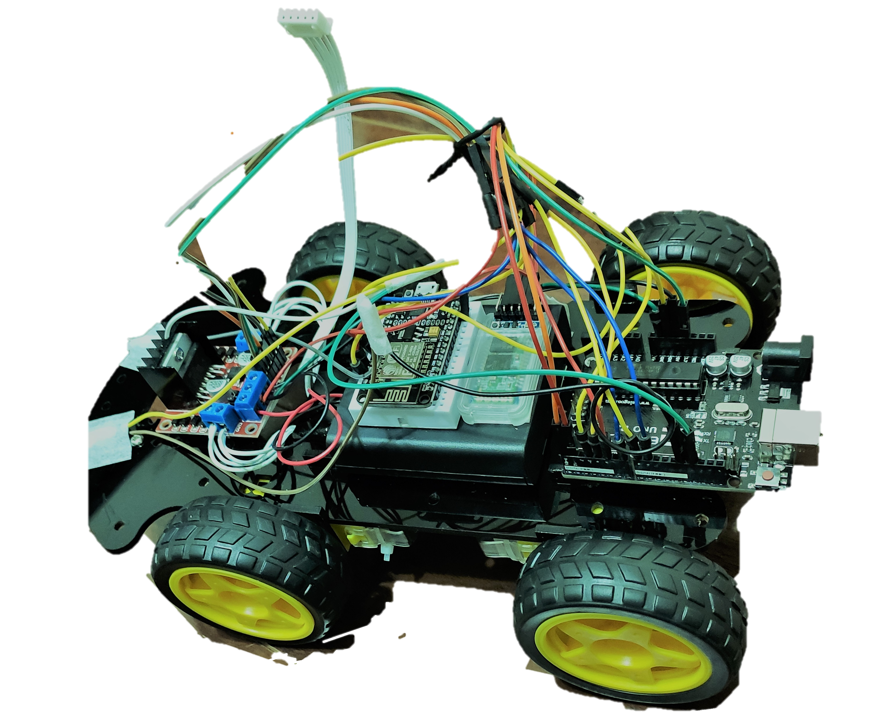
Wi-fi & Bluetooth Control
The wireless car is controlled via smartphone which is connected to the Bluetooth module and a Wi-Fi module.
Now a days due to advancement in technology various newly designed smart homes make use of Wi-Fi enabled robot for various applications.
Robot car controlled by Wi-Fi will make our work much easier as we can make the robot do any work, we need by just a single movement on our mobile phone on computer.

Slide 7

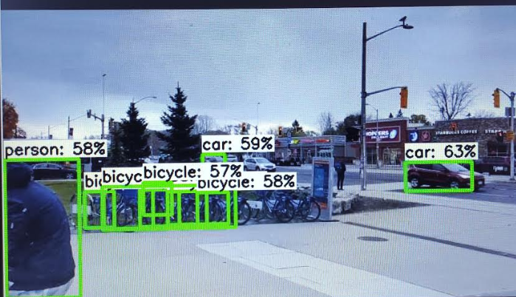
Image & Video Processing
The Raspberry Pi is a very cheap computer that runs Linux, but it also provides a set of GPIO (general purpose input/output) pins that allow you to control electronic components.
OpenCV (Open Source Computer Vision Library) is an open source computer vision and machine learning software library. It was developed so that real-time analytics of images and recognition can be done for assorted applications

Slide 8

Automation Solutions
Obstacle Avoidance
Wi-Fi & Bluetooth Control
The obstacle avoidance robotics is used for detecting obstacles and avoiding the collision. This is an autonomous robot..
Can be able to control the car with Wi/-fi and Bluetooth from phone.
Robotic Arm with Gripper
Video Processing – Raspberry Pi
The robotic arm is used for multiple industrial applications. Also Can be use in various method such as to create a line, hold some object..
Installed camera can detect the real time traffic signal and can identify the cars, peoples on the road.
Line Follower
Image Processing – Raspberry Pi
Can be use in Industry sector, shopping mall, health car and can be used in long distance..
The car can be used as security vehicle to take pictures and those can be accessible directly from your own computer.
Autonomous Car

Slide 9

THANK YOU

